Slide 1
Foundations of Cryptography one-way permutation, hard-core predicate, Goldreich-Levin theorem, PRG from HCP
LiangFeng Zhang
zhanglf@shanghaitech.edu.cn

Slide 2
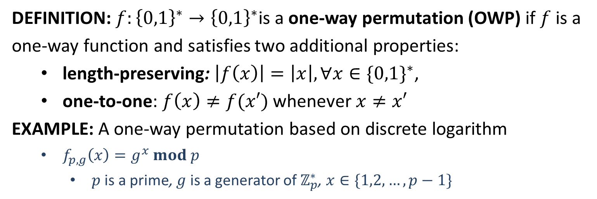
One-Way Permutation
DEFINITION: $f:{\left\{0,1\right\}}^{∗}→{\left\{0,1\right\}}^{∗}$is a one-way permutation (OWP) if $f$ is a one-way function and satisfies two additional properties:
length-preserving: $\left|f\left(x\right)\right|=\left|x\right|, ∀x∈\{0,1\}^{∗}$,
one-to-one: $f\left(x\right)≠f(x′)$ whenever $x≠x′$
EXAMPLE: A one-way permutation based on discrete logarithm
$f_{p,g}\left(x\right)=g^{x} mod p$
$p$ is a prime, $g$ is a generator of $ℤ_{p}^{∗}$, $x∈\{1,2,…,p−1\}$

Slide 3
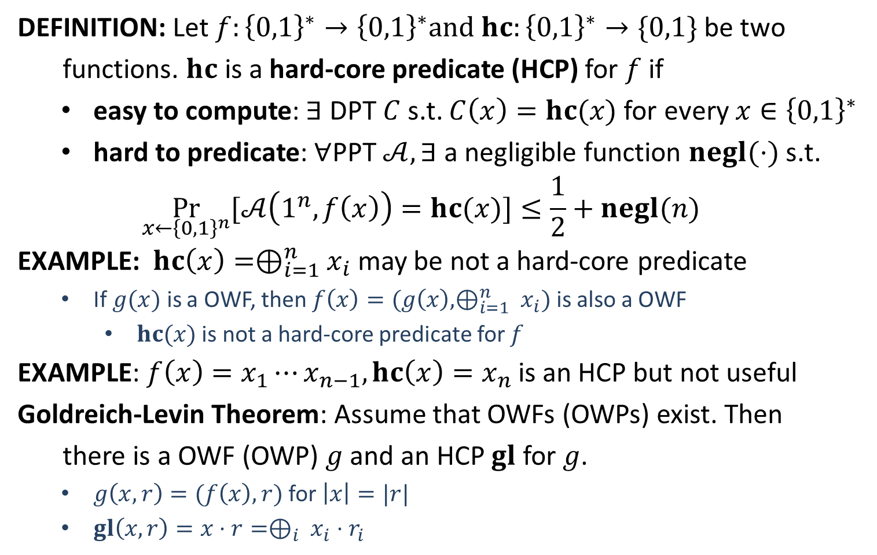
Hard-Core Predicate
DEFINITION: Let $f:{\left\{0,1\right\}}^{∗}→{\left\{0,1\right\}}^{∗}and hc:{\left\{0,1\right\}}^{∗}→\{0,1\}$ be two
functions. $hc$ is a hard-core predicate (HCP) for $f$ if
easy to compute: $∃$ DPT $C$ s.t. $C\left(x\right)=hc(x)$ for every $x∈{\left\{0,1\right\}}^{∗}$
hard to predicate: $∀$PPT $𝒜, ∃$ a negligible function $negl(⋅)$ s.t.
$$\underset{x←{\left\{0,1\right\}}^{n}}{Pr}{[𝒜\left(1^{n}, f\left(x\right)\right)=hc(x)]}≤\frac{1}{2}+negl(n)$$
EXAMPLE: $hc\left(x\right)=⊕_{i=1}^{n}x_{i}$ may be not a hard-core predicate
If $g(x)$ is a OWF, then $f\left(x\right)=(g\left(x\right), ⊕_{i=1}^{n} x_{i})$ is also a OWF
$hc(x)$ is not a hard-core predicate for $f$
EXAMPLE: $f\left(x\right)=x_{1}⋯x_{n−1}, hc\left(x\right)=x_{n}$ is an HCP but not useful
Goldreich-Levin Theorem: Assume that OWFs (OWPs) exist. Then
there is a OWF (OWP) $g$ and an HCP $gl$ for $g$.
$g\left(x,r\right)=(f\left(x\right),r)$ for $\left|x\right|=|r|$
$gl\left(x,r\right)=x⋅r=⊕_{i} x_{i}⋅r_{i}$

Slide 4
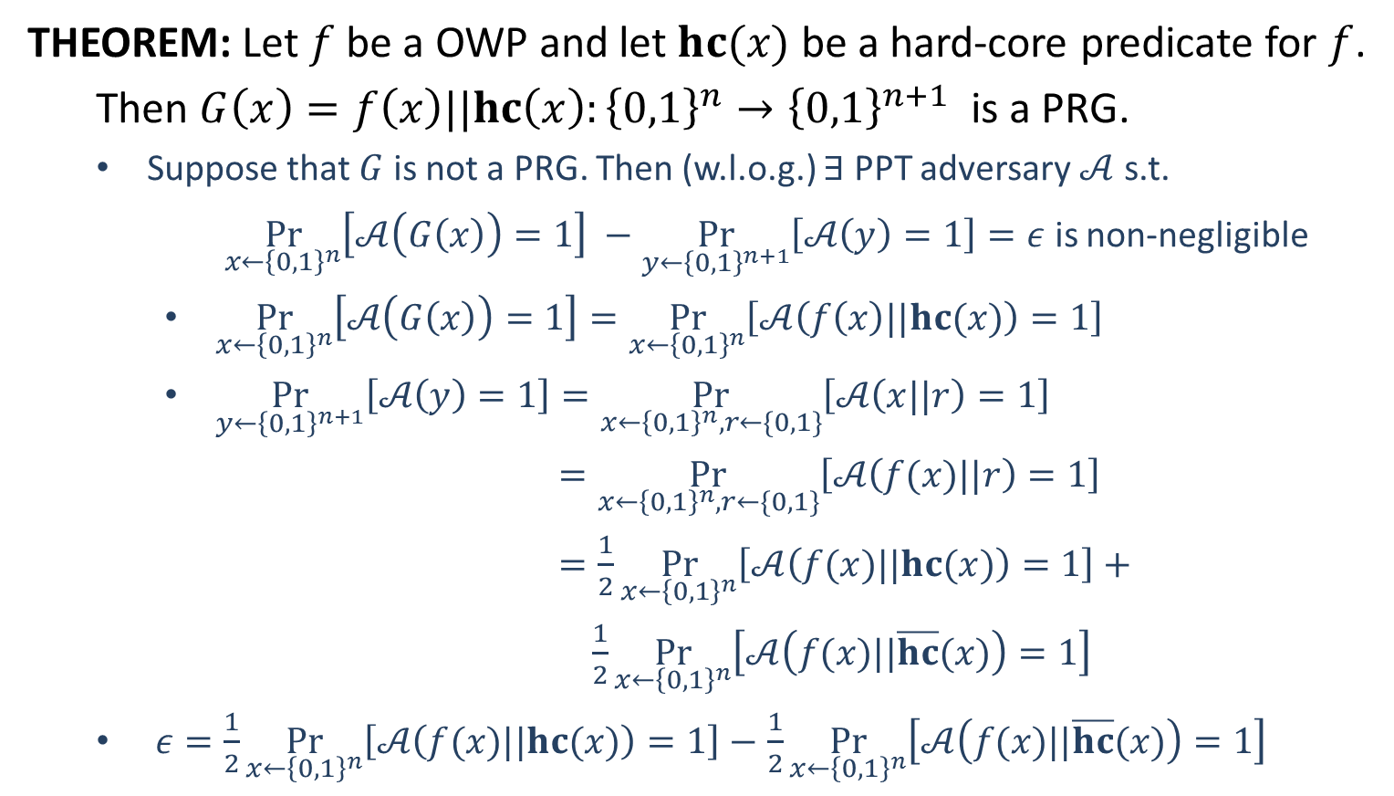
PRG from HCP
THEOREM: Let $f$ be a OWP and let $hc(x)$ be a hard-core predicate for $f$.
Then $G\left(x\right)=f\left(x\right)||hc\left(x\right):{\left\{0,1\right\}}^{n}→{\left\{0,1\right\}}^{n+1}$ is a PRG.
Suppose that $G$ is not a PRG. Then (w.l.o.g.) $∃$ PPT adversary $𝒜$ s.t.
$\underset{x←{\left\{0,1\right\}}^{n}}{Pr}\left[𝒜\left(G\left(x\right)\right)=1\right] −\underset{y←{\left\{0,1\right\}}^{n+1}}{Pr}\left[𝒜\left(y\right)=1\right]=ε$ is non-negligible
$\underset{x←{\left\{0,1\right\}}^{n}}{Pr}\left[𝒜\left(G\left(x\right)\right)=1\right]=\underset{x←{\left\{0,1\right\}}^{n}}{Pr}\left[𝒜\left(f\left(x\right)||hc(x)\right)=1\right]$
$\underset{y←{\left\{0,1\right\}}^{n+1}}{Pr}\left[𝒜\left(y\right)=1\right]=\underset{x←{\left\{0,1\right\}}^{n}, r←\{0,1\}}{Pr}\left[𝒜\left(x||r\right)=1\right]$
$=\underset{x←{\left\{0,1\right\}}^{n}, r←\{0,1\}}{Pr}\left[𝒜\left(f(x)||r\right)=1\right]$
$=\frac{1}{2}\underset{x←{\left\{0,1\right\}}^{n}}{Pr}\left[𝒜\left(f(x)||hc(x)\right)=1\right]+$
$\frac{1}{2}\underset{x←{\left\{0,1\right\}}^{n}}{Pr}\left[𝒜\left(f(x)||\overline{hc}(x)\right)=1\right]$
$ε=\frac{1}{2}\underset{x←{\left\{0,1\right\}}^{n}}{Pr}\left[𝒜\left(f(x)||hc(x)\right)=1\right]−$ $\frac{1}{2}\underset{x←{\left\{0,1\right\}}^{n}}{Pr}\left[𝒜\left(f(x)||\overline{hc}(x)\right)=1\right]$

Slide 5
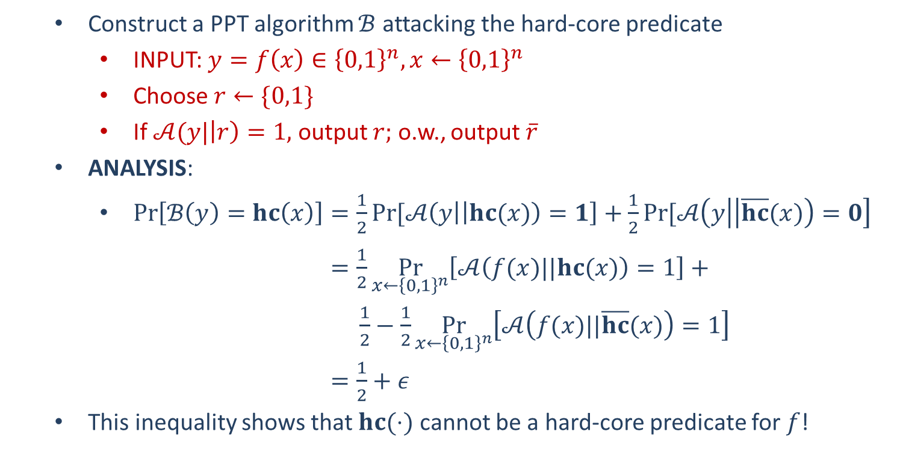
PRG from HCP
Construct a PPT algorithm $ℬ$ attacking the hard-core predicate
INPUT: $y=f\left(x\right)∈{\left\{0,1\right\}}^{n}, x←{\left\{0,1\right\}}^{n}$
Choose $r←\{0,1\}$
If $𝒜(y|\left|r\right)=1,$ output $r;$ o.w., output $\overline{r}$
ANALYSIS:
$\operatorname{Pr}\left[ℬ\left(y\right)=hc\left(x\right)\right]=\frac{1}{2}Pr⁡[𝒜\left(y | \left|hc(x)\right)=1\right]+\frac{1}{2}Pr⁡[𝒜\left(y | \left|\overline{hc}(x)\right)=0\right]$
$=\frac{1}{2}\underset{x←{\left\{0,1\right\}}^{n}}{Pr}\left[𝒜\left(f(x)||hc(x)\right)=1\right]+$
$\frac{1}{2}−\frac{1}{2}\underset{x←{\left\{0,1\right\}}^{n}}{Pr}\left[𝒜\left(f(x)||\overline{hc}(x)\right)=1\right]$
$=\frac{1}{2}+ε$
This inequality shows that $hc(⋅)$ cannot be a hard-core predicate for $f$!

